Slide 1


SIMATS ENGINEERING
SAVEETHA INSTITUTE OF MEDICAL AND TECHNICAL SCIENCES
Capstone project presentation
AI-Based Predictive Analytics for Smart Cities and Urban Planning
CSA1712 - ARTIFICIAL INTELLIGENCE
Guided By:-
Dr. Veeramani
Presented by:
Bairagani Dinesh(192372189)
Nellore Srinadh(192311086)

Slide 2

INTRODUCTION
Smart City Data Growth:
Modern cities generate huge amounts of data through sensors, traffic cameras,
GPS systems, weather stations, public transportation, and social media
platforms.
Need for Urban Data :
Managing urban resources manually is difficult because of the large volume and
complexity of city data.
Use of Data :
Data Mining techniques help discover hidden patterns, trends, and relationships
from urban datasets for better city planning.
Application of Predictive Analytics:
Predictive analytics enables city administrators to forecast traffic congestion,
pollution levels, population growth, and infrastructure requirements.

Slide 3
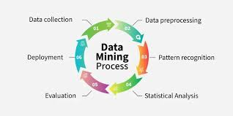
ABSTRACT
Smart cities generate large amounts of data from sources such as traffic sensors, GPS devices, weather stations, public transportation systems, and government databases.
Traditional urban planning methods face difficulties in managing and analyzing this continuously growing data effectively.
The proposed system uses Data Mining and Predictive Analytics techniques to extract useful patterns, trends, and knowledge from urban datasets.
The system collects, preprocesses, and integrates data from multiple smart city sources to ensure accurate analysis.
Data mining algorithms such as K-Means Clustering, Decision Tree, and Random Forest.

Slide 4
PROBLEM STATEMENT
Rapid urbanization has increased challenges related to traffic congestion, pollution, energy consumption, and infrastructure management.
Traditional planning methods are unable to efficiently analyze large-scale urban data generated continuously by smart city devices.
City administrators often lack real-time insights into urban conditions, resulting in delayed responses and inefficient resource utilization.
There is a need for an intelligent system that can collect, analyze, predict, and visualize urban data to support effective smart city planning and management.

Slide 5
OBJECTIVES
To collect and integrate urban data from multiple smart city sources such as traffic sensors, GPS systems, weather stations, and public databases.
To develop a predictive analytics framework using data mining techniques for urban planning and smart city management.
To identify traffic congestion patterns, pollution hotspots, and population growth trends.
To create a centralized data warehouse for storing and managing urban data efficiently.
To develop an interactive visualization dashboard for city authorities to monitor and analyze urban conditions.

Slide 6
DATA SET
The dataset used in this project consists of urban planning and smart city data collected from various sources.
Dataset Attributes:-
Traffic Volume
Vehicle Speed
Population Density
Air Quality Index (AQI)
Temperature
Public Transport Usage
Energy Consumption
Geographic Location
The dataset contains structured and semi-structured information suitable for predictive analytics and data mining applications.
The collected data helps identify urban patterns and improve city planning strategies.

Slide 7
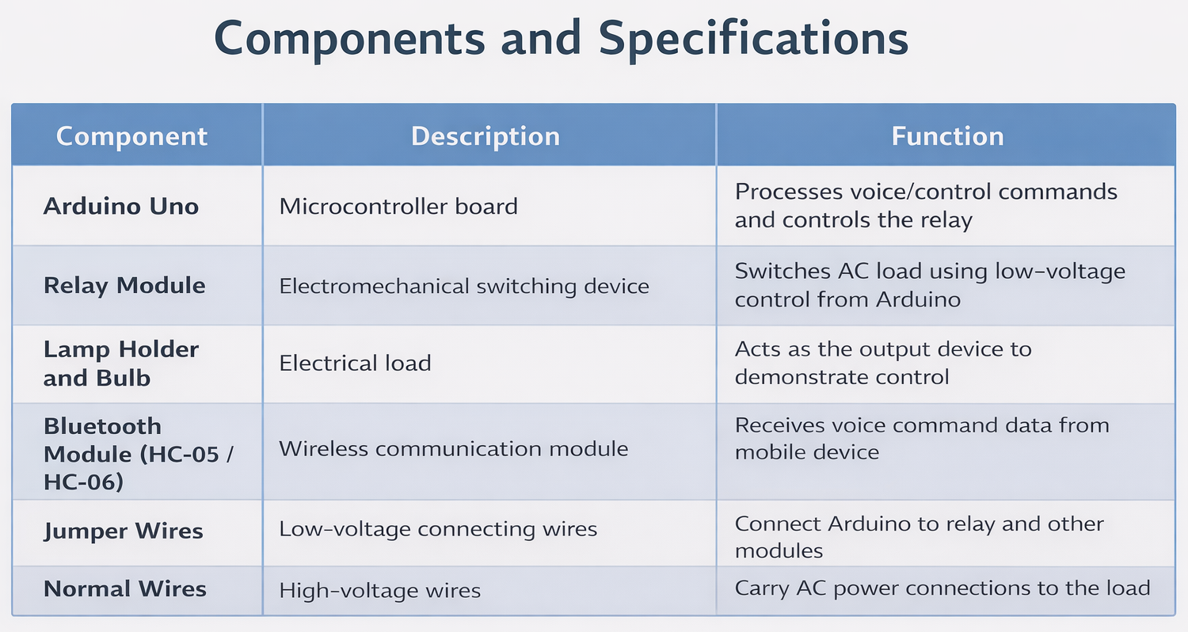
LITERATURE REVIEW
Year | Paper / Study | Method Used | Advantage | Disadvantage | Outcome | Helpful for Our Study
2023 | Smart City Data Analytics for Urban Planning | Data Mining & Big Data Analytics | Identifies urban patterns from large datasets | Requires large amounts of data | Improved city planning decisions | Helps us understand urban data analysis techniques
2023 | Traffic Congestion Prediction Using Machine Learning | Decision Tree Algorithm | Predicts traffic congestion effectively | Accuracy depends on data quality | Improved traffic management | Helps our traffic prediction module
2024 | Urban Pollution Monitoring Using IoT and Data Mining | IoT Sensors + Data Mining | Real-time pollution monitoring | High sensor deployment cost | Detects pollution hotspots | Supports our pollution analysis module

Slide 8
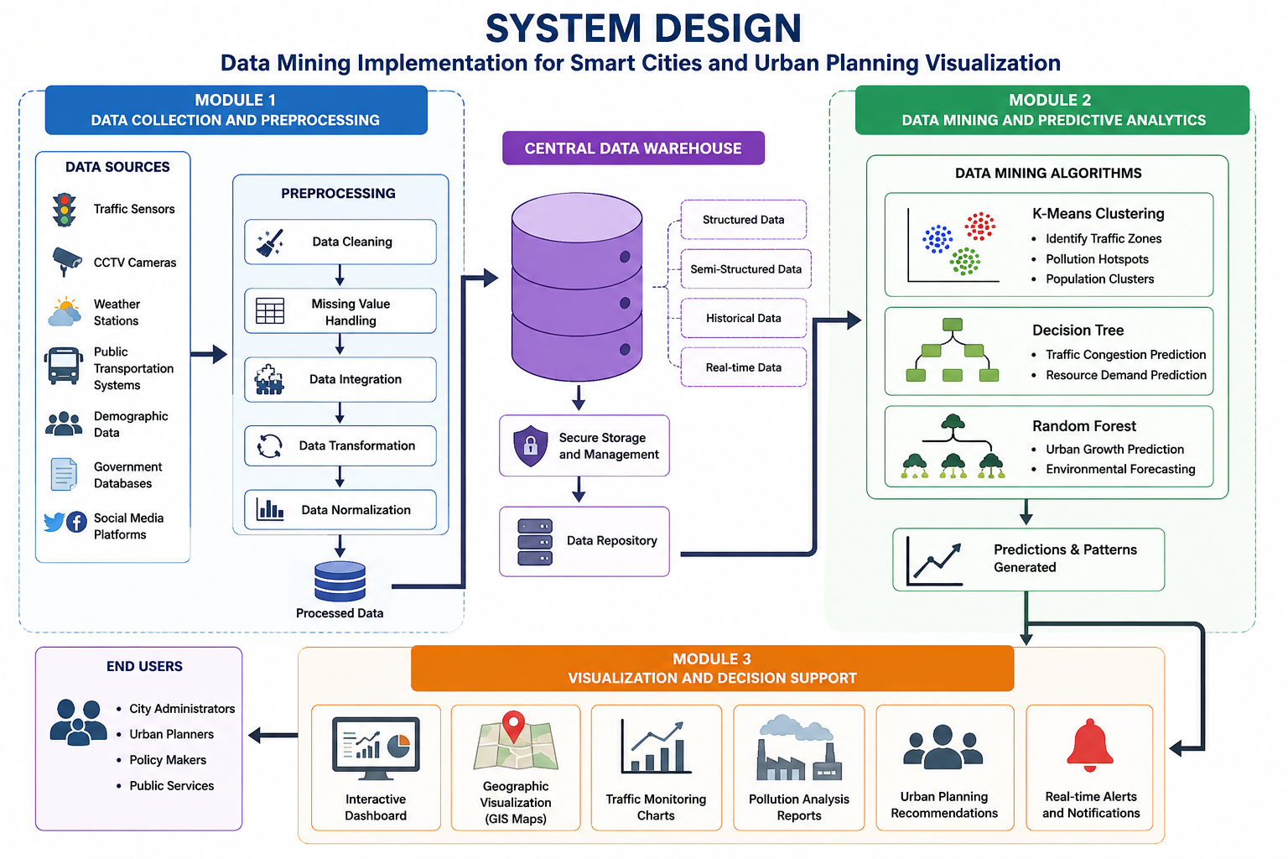
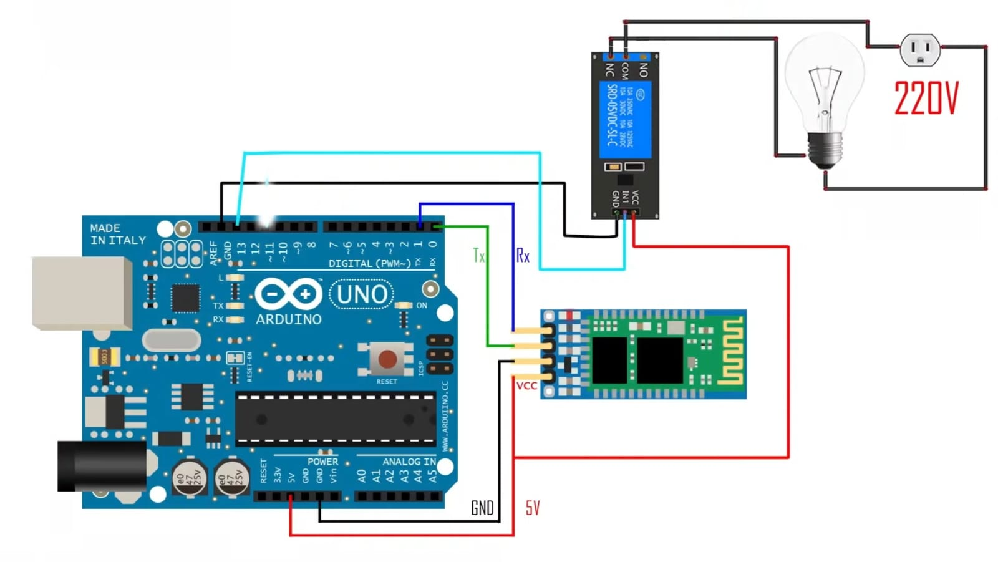
SYSTEM DESIGN

Slide 9
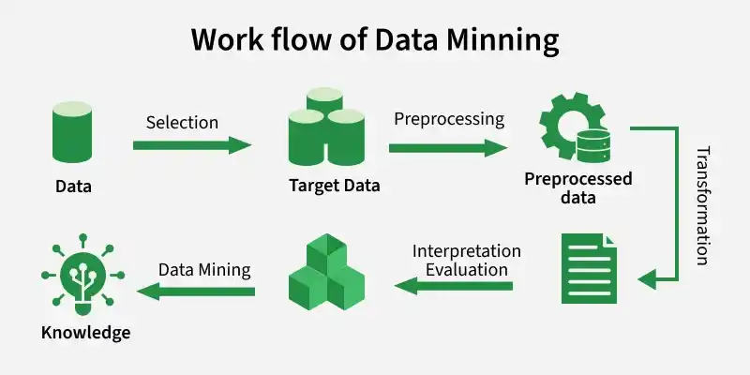
Module 1:Data Collection and Preprocessing Module
Collects urban data from multiple sources such as traffic sensors, GPS devices, weather stations, public transportation systems, government databases, and social media platforms.
Gathers both real-time and historical city data for analysis.
Removes duplicate, incomplete, and inconsistent records from the collected data.
Handles missing values and corrects data quality issues.
Integrates data from different sources into a unified format.
Transforms and normalizes the data for efficient processing.
Stores the cleaned and processed data in the centralized data warehouse for further analysis.

Slide 10
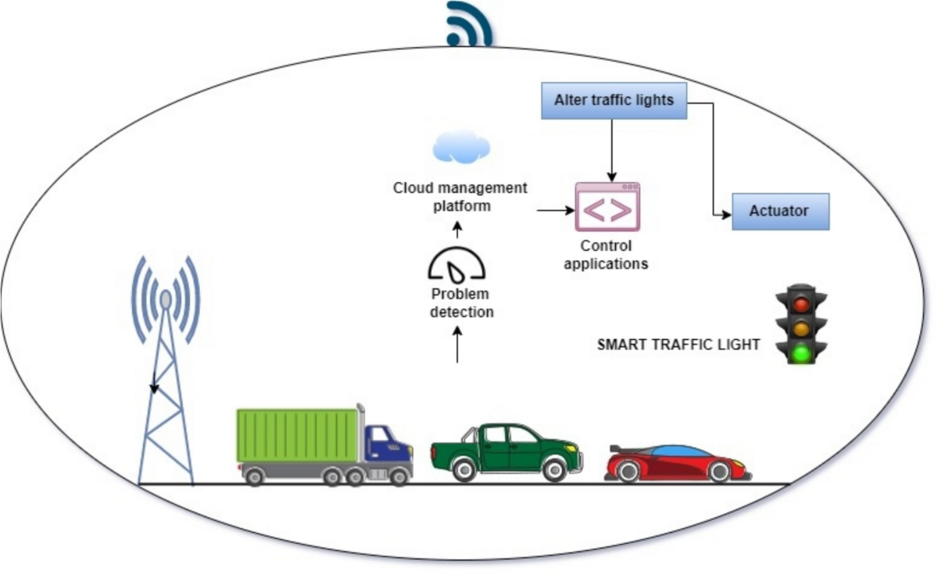
Module 2: Sentiment Analysis and Classification Module
Receives the cleaned and processed urban data from the preprocessing module.
Applies data mining techniques to discover hidden patterns and relationships.
Uses K-Means Clustering to identify traffic zones, pollution hotspots, and population clusters.
Uses Decision Tree algorithms for traffic congestion and resource demand prediction.
Uses Random Forest algorithms for urban growth forecasting and environmental analysis.
Generates predictive insights and trend analysis for smart city planning.
Stores the analytical results and predictions in the database for visualization and reporting.

Slide 11
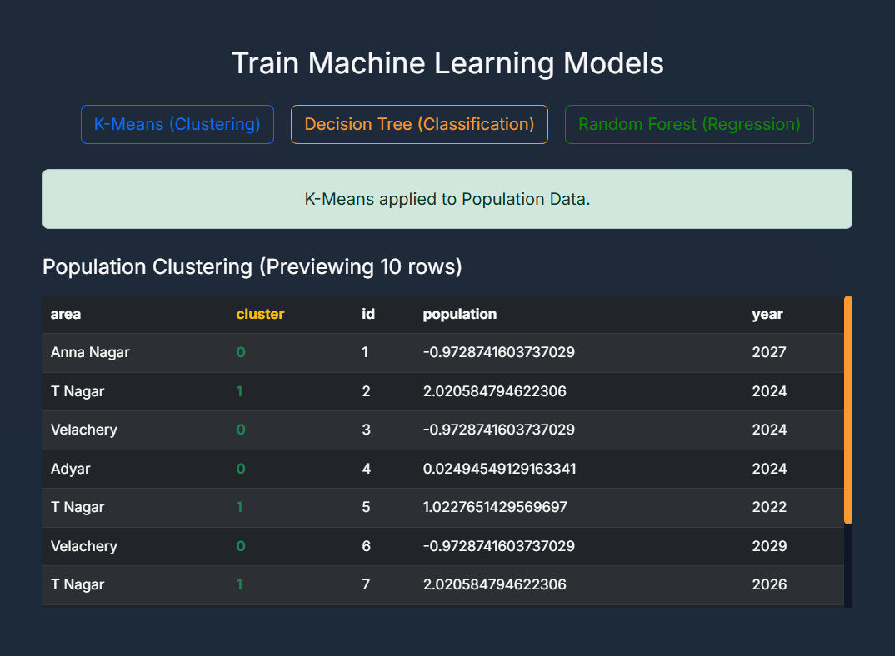
Module 3: Visualization and Reporting Module
Receives analytical results and predictions from the data mining module.
Stores the results in a structured database for reporting and future analysis.
Creates interactive dashboards for monitoring smart city activities.
Displays traffic congestion analysis using charts and graphs.
Visualizes pollution levels and environmental conditions through maps and reports.
Provides urban planning recommendations based on predictive analytics results.

Slide 12
METHODOLOGY
Data Collection:
Collect urban data from traffic sensors, GPS devices, weather stations, public
transportation systems, and government databases.
Data Preprocessing:
Clean, integrate, transform, and normalize the collected data to improve quality and
consistency.
Data Mining & Analysis:
Apply data mining techniques such as K-Means Clustering to identify traffic zones,
pollution hotspots, and urban patterns.
Predictive Analytics:
Use Decision Tree and Random Forest algorithms to predict traffic congestion,
urban growth, and resource demand.

Slide 13
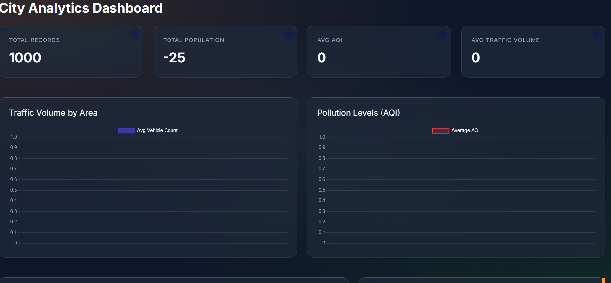
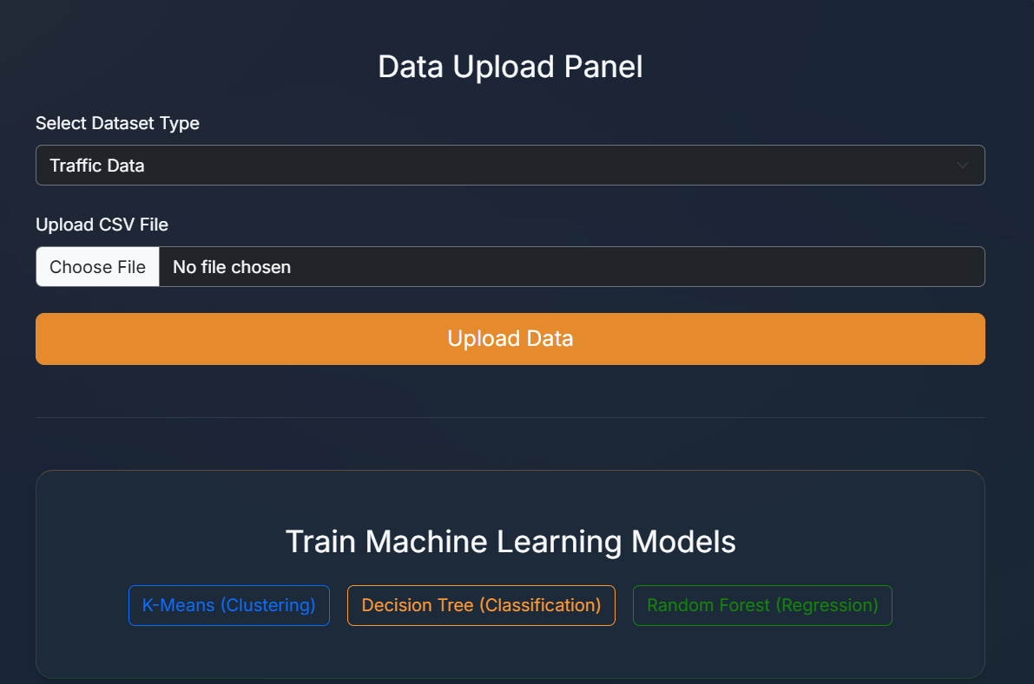
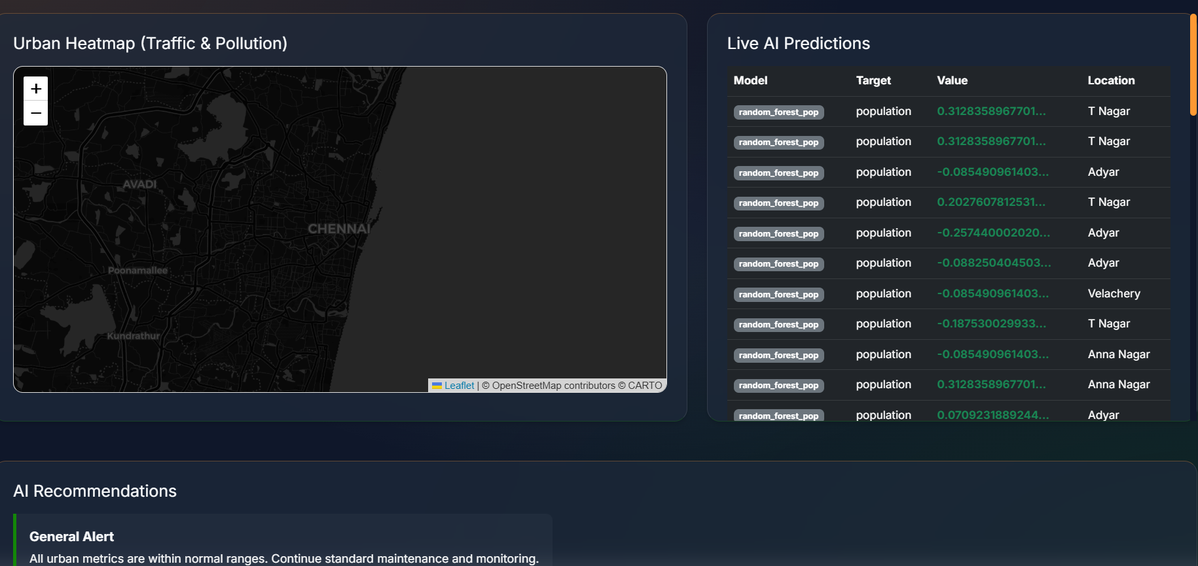
RESULTS & DISCUSSION

Slide 14
CONCLUSION & FUTURE SCOPE
The proposed Smart City Urban Planning System successfully utilizes Data Mining and Predictive Analytics techniques to analyze large-scale urban data.
The system effectively identifies traffic congestion patterns, pollution hotspots, and urban growth trends.
Data mining algorithms help transform raw city data into meaningful insights for better decision-making.
Interactive dashboards and visualizations provide clear and real-time monitoring of urban conditions.
The project supports sustainable urban development by improving resource allocation, transportation planning, and city management

Slide 15
REFERENCES
□
Cambria, E., Schuller, B., Xia, Y., & Havasi, C. (2023). New Avenues in Opinion Mining and Sentiment Analysis. IEEE Intelligent Systems, 28(2), 15–21.
Devlin, J., Chang, M.-W., Lee, K., & Toutanova, K. (2019). BERT: Pre-training of Deep Bidirectional Transformers for Language Understanding. In Proceedings of NAACL-HLT.
Pak, A., & Paroubek, P. (2010). Twitter as a Corpus for Sentiment Analysis and Opinion Mining. LREC 2010.
Feldman, R. (2013). Techniques and Applications for Sentiment Analysis. Communications of the ACM, 56(4), 82–89.

Slide 16


